Slide 1
Sentiment Analysis on Vodafone tweets
By Chloe Acheampong

Slide 2
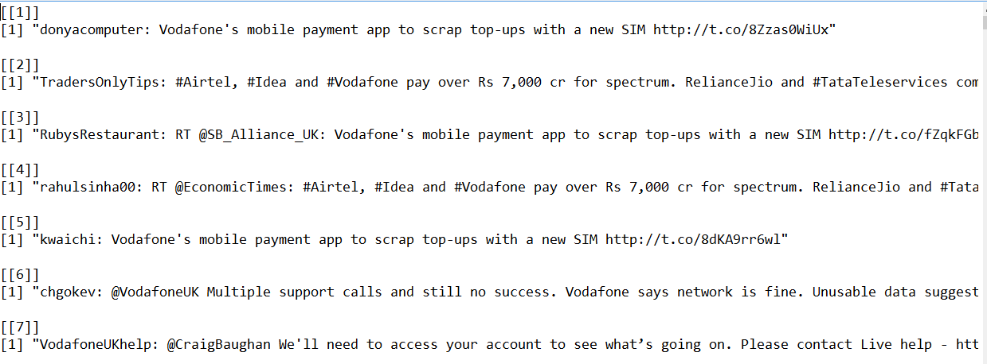
Raw Data
2000 tweets about Vodafone from Twitter

Slide 3
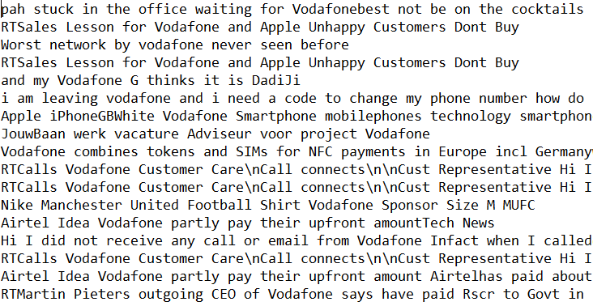
Data cleaning
Digits
Names
Retweets
Spaces
Empty lines
HTML links
Punctuations
Add Ghana context

Slide 4
Purpose
To assess the performance of Vodafone using these tweets
Anger
Positive
OR
Joy
Negative
Fear
Neutral
Sadness

Slide 5
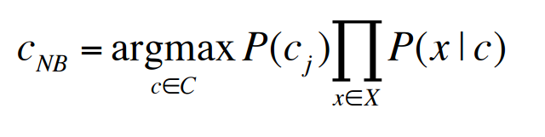
Algorithm
Naïve Bayes Classifier
Independence assumption of predictors
Probabilities prior p(negative) * p(“word”| negative)

Slide 6
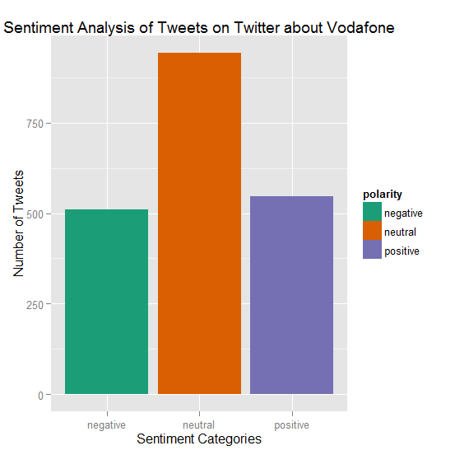
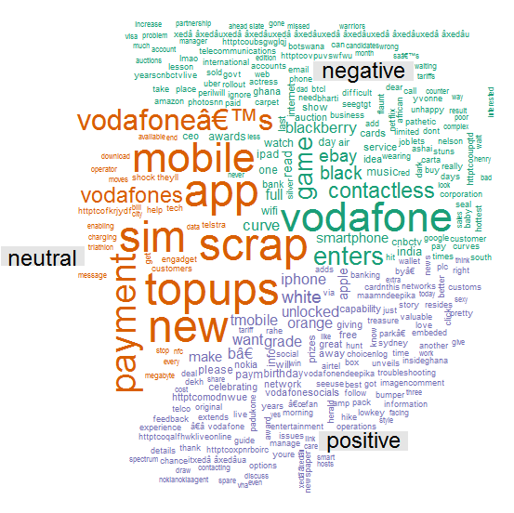
Vodafone

Slide 7
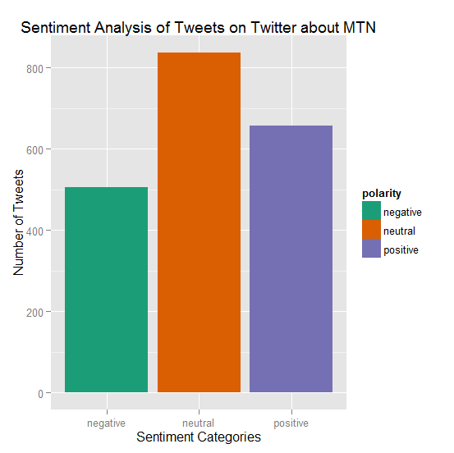
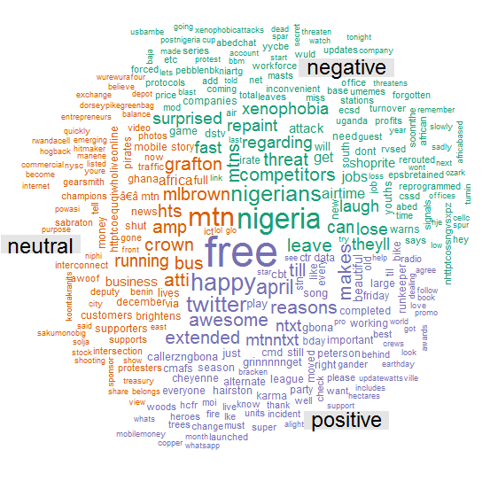
MTN

Slide 8
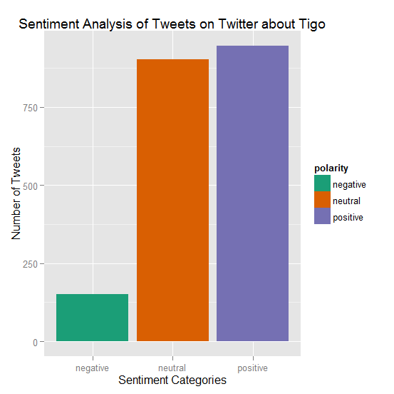
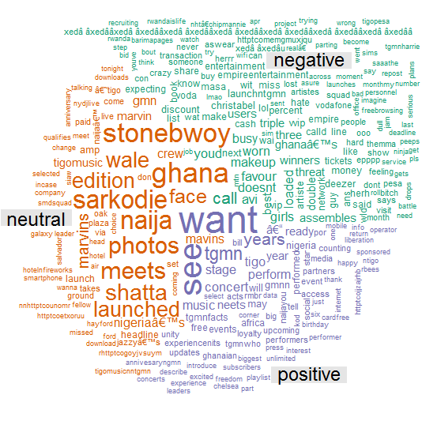
Tigo

Slide 9
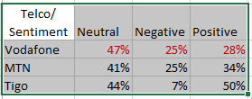
Observations

Slide 10
Conclusion
Vodafone is performing fairly well in the market but could do better.

Slide 11
Sources
http://www.rdatamining.com/examples/text-mining
https://mkmanu.wordpress.com/2014/08/05/sentiment-analysis-on-twitter-data-text-analytics-tutorial/
https://apps.twitter.com/app/8138221/keys
https://www.linkedin.com/groups/Sentiment-package-R-2613414.S.103850806

